Slide 1


Bhujbal Knowledge City
Institute of Engineering
Department of Artificial Intelligence and Data Science Engineering
Project Based Learning (110013)
A Project Presentation on Topic
WEATHER FORECASTING USING MACHINE LEARNING
:: Presented By ::
:: Under the Guidance of ::
PAWAR AARYA PRASHANT
PATIL MAYURI KISHOR
SONAWANE CHAITALI PRASHANT
4. PATIL SNEHA SUNIL
Prof. Amol J. Gosavi
Students from FE AI & DS, Semester-II, A.Y.-2022-23

Slide 2
Bhujbal Knowledge City
Institute of Engineering
Contents
Department of Artificial Intelligence and Data Science
Abstract
Introduction
Literature Survey
Problem Statement
Motivation
Scope of the Project
Objectives
Requirement Analysis
Software Requirement Specification
Methodology (Algorithm details )
Software and Hardware Requirements
Challenges Faced
Conclusion and Future Scope
References

Slide 3
Bhujbal Knowledge City
Institute of Engineering
Abstract
Department of Artificial Intelligence and Data Science
Weather Forecasting is the application of science and technology to predict the conditions of the atmosphere for given location and time.
Weather Forecasts are made by collecting quantitative data about the current state of the atmosphere at a given place and using meteorology to project how the atmosphere will change.
The main objective of this paper is to design an effective weather prediction model by the use of
multivariate regression or multiple linear regressions and support vector machine (SVM).Weather is an important aspect of a person’s life as it can help us to know when it’ll rain and when it’ll be sunny.
Weather forecasting is the attempt by meteorologists to predict the weather conditions at some future time and the
weather conditions that may be expected. The climatic condition parameters are based on the tempe rature,
7/8/23
Project Name
3
Notes:
3

Slide 4
Bhujbal Knowledge City
Institute of Engineering
Motivation
Department of Artificial Intelligence and Data Science
We got motivated to do project on Weather Forecasting because,
Forecasting of weather is very important.
Weather Forecasting helps people to about climate changes in advance, so as per that they can
make there future plans.
7/8/23
Project Name
4

Slide 5
Bhujbal Knowledge City
Institute of Engineering
Introduction
Department of Artificial Intelligence and Data Science
Weather forecasting is basically the prediction of the future weather and for the specified geographical location.
Weather conditions are changing very rapidly around the world and it affects all the major areas.
Weather forecasts become very essential in today’s world. Today we are heavily depend on weather forecasts whether it is from industrial to agriculture, from travelling to daily commuting, anything where weather plays a role. For the easy and
seamless mobility it becomes very important that we predict the weather correctly and ensure that it has no error.
The Scientists are still in working process of overcoming the limitations of computer models to improvise the
accuracy rate of prediction through recent technologies of adding intelligence to machine. To add intelligence for
system as human we have given a study platform called Artificial Neural networks, Machine learning, rule based
techniques where there exist ample impetus to study the weather occurrence and prediction.
Here we implemented machine learning algorithm is Scikit’s learn linear regression model. A large historical
datasets of Austin was obtained and used to train this algorithm. The input was the weather conditions of Austin of
many years and thus the output obtained is weather condition of upcoming days.
7/8/23
Project Name
5

Slide 6
Bhujbal Knowledge City
Institute of Engineering
Literature Survey
Department of Artificial Intelligence and Data Science
"Analysis on the weather forecastingand technique" by Janani.B, Priyanka Sebastian.
"Issues with weather prediction" by Samenow & Fritz
"Machine Learning Applied to Weather Forecasting" by Mark Holmstrom
" The weather forecast" by Bengtsson L
''Weather prediction" by Kan L, Yu-Shu L
7/8/23
Project Name
6

Slide 7
Bhujbal Knowledge City
Institute of Engineering
Problem Statement
Department of Artificial Intelligence and Data Science
Users can get too busy at work or at home to check the current weather condition for sever weather. Many of the free weather software programs have too many pop ups or unwanted software tied to them like weather bug.
Getting confusing information on weather warnings and watches from inaccurate sources.
This allows to predict the condition if weather approximately, on daily basis..
7/8/23
Project Name
7

Slide 8
Bhujbal Knowledge City
Institute of Engineering
Motivation
Department of Artificial Intelligence and Data Science
We got motivated to do project on Weather Forecasting because,
Forecasting of weather is very important.
Weather Forecasting helps people to about climate changes in advance, so as per that they can
make there future plans.
7/8/23
Project Name
8

Slide 9
Bhujbal Knowledge City
Institute of Engineering
Scope of the Project
Department of Artificial Intelligence and Data Science
It let us know how many inches of rain can we expect.
Let us know about the weather conditions .
We can know about Humidity.
It will tell us about Temperature.
7/8/23
Project Name
9

Slide 10
Bhujbal Knowledge City
Institute of Engineering
Objectives
Department of Artificial Intelligence and Data Science
Weather Forecasting is crucial since it helps to determine future climate changes.
The main objective of this paper is to design an effective weather prediction model by the use of multivariate regression or multiple linear regressions and support vect machine (SVM).
Fullfill the requirement of SSPU
7/8/23
Project Name
10

Slide 11
Bhujbal Knowledge City
Institute of Engineering
Requirement Analysis
Department of Artificial Intelligence and Data Science
The system shall be able to produce minimum, maximum and the average data of a particular weather parameter when it is requested by an operator.
The system shall provide the following weather parameters: temperature, pressure, wind speed & direction, rainfall, and humidity.
7/8/23
Project Name
11

Slide 12
Bhujbal Knowledge City
Institute of Engineering
Software Requirement Specification
Department of Artificial Intelligence and Data Science
Software Used for this Project is online platform i.e Jupyter Notebook, known as Ipython where in we have done our source code for predicting the weather.
This platform is open-source web application which allows us to create and share the document which contains the code.
7/8/23
Project Name
12

Slide 13
Bhujbal Knowledge City
Institute of Engineering
Methodology / Algorithms details
Department of Artificial Intelligence and Data Science
Linear Regression is a machine learning algorithm based on supervised learning. It performs a regression task. Regression models a target prediction value based on independent variables. It is mostly used for finding out the relationship between variables and forecasting. Different regression models differ based on - the kind of relationship between dependent and independent variables, they are consideringand the number of independent variables being used.
wttr - the right way to check the weather!wttr.in is a console-oriented weather forecast service that supports various information representation methods like terminal-oriented ANSI-sequences for console HTTP clients (curl, httpie, or wget), HTML for web browsers, or PNG for graphical viewers.wttr.in uses wego for visualization and various data sources for weather forecast information.
Requests Module:Requests is a simple, yet elegant HTTP library. It allows you to send HTTP/1.1 requests extremely easily. Requests officially supports Python 2.7 & 3.5+.
7/8/23
Project Name
13

Slide 14
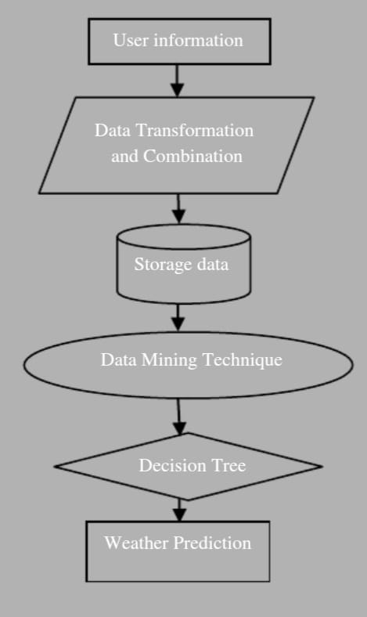
Bhujbal Knowledge City
Institute of Engineering
Flowchart of the process

Slide 15
Bhujbal Knowledge City
Institute of Engineering
Software and Hardware Requirements
Department of Computer Engineering
Hardware/Software | Hardware/Software Elements | Specification/ Version
Software | OS | Windows, Linux
IDE | Jupyter Notebook
Hardware | Processor | i5
Hard Disk | 250GB
7/8/23
Project Name
15

Slide 16
Bhujbal Knowledge City
Institute of Engineering
Challenges Faced
Department of Computer Engineering
Technical Expertise: We faced difficulties in acquiring the necessary technical expertise and knowledge in areas such as machine learning, data analysis and optimization techniques.
Time and Resource Management: Balancing project requirements with other academic is challenging.
7/8/23
Project Name
16

Slide 17
Bhujbal Knowledge City
Institute of Engineering
Conclusion and Future Scope
Department of Computer Engineering
The weather prediction done using Jupyter Notebook is very essential for improving the future performance for the people. For predicting the weather, requests module and wttr are applied to the datasets of the weather.
We made a model to predict the weather using some selected input variables collected from Kaggle. The problem with current weather scenario is that we are not able to prepare our self and not able to do some important works
7/8/23
Project Name
17

Slide 18
Bhujbal Knowledge City
Institute of Engineering
References
Department of Computer Engineering
[1] Janani.B,Priyanka Sebastian. (2014). Analysis on the weather forecasting and technique. (3rd ed). IJARCET.
[2] Samenow & Fritz. (2015). Issues with weather prediction.
[3] Mark Holmstrom, Dylan Liu, and Christopher Vo. 2016. Machine LearningApplied to Weather Forecasting
[4] Bengtsson L (1980) The weather forecast. Pure Appl Geophys 119(3):515- 537
[5] Kan L, Yu-Shu L (2002) Fuzzy case-based reasoning: weather prediction.In: Proceedings of the international conference on machine learning and cybernetics, vol 1. pp 107-110
[6] Dhanashree S. Medhekar, Mayur P. Bote, Shruti D. Deshmukh, "Heart Disease Prediction System using Naive Bayes", INTERNATIONAL JOURNAL OF ENHANCED RESEARCH IN SCIENCE TECHNOLOGY & ENGINEERING, VOL. 2, ISSUE 3, MARCH-2013, pp 1-5
THANK YOU….
7/8/23
18

